Slide 1
October 8 Update

Slide 2

Fourier coefficient extraction algorithm

Slide 3
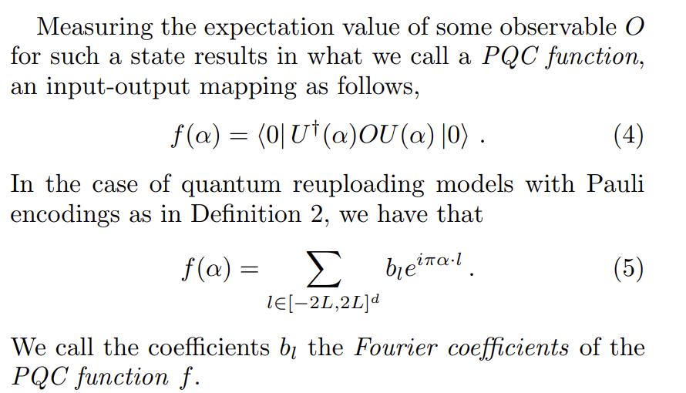

Slide 4



Slide 5


Slide 6
Things to do

